Slide 1

KYAMBOGO UNIVERSITY FACULTY OF ENGINEERING DEPARTMENT OF ELECTRICAL AND ELECTRONICS BACHELOR OF ENGINEERING IN TELECOMMUNICATIONS ENGINEERING FINAL YEAR PROJECT PRESENTATION SLIDES PRESENTED BY: MBOGO ABDULWAHABU 19/U/ETD/18425/GV KWOBA FREDRICK 18/U/ETE/10180/PE SUPERVISOR:MR.KAGUDDE ABBAS

Slide 2
Project Title
A COMPARATIVE STUDY OF FBMC MODULATION TECHNIQUE WITH NATIVE OFDM IN A DVB-T2 SYSTEM

Slide 3
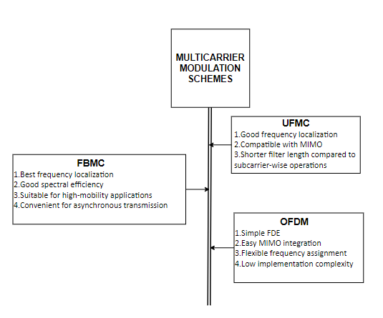
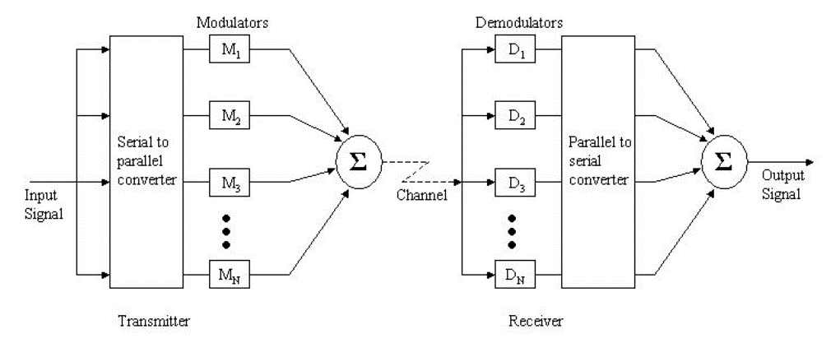
INTRODUCTION
GENERIC MULTI-CARRIER SYSTEM
WHY MULTICARRIER SCHEMES

Slide 4
Problem Statement
In wireless communications, OFDM being by far the most adopted scheme, has continuously proved its compatibility with the existing systems, low complexity but there is still need for increased data rates, lesser error transmissions and low out of band emissions
Several researches have proved that FBMC provides better performance in wireless communications due to its proper spectral containment of signals and the effective use of the spectrum as the CP is unnecessary
This study aims to investigate whether FBMC can be a better alternative to OFDM specifically in DVB-T2 systems by evaluating its performance using parameters, SNR, MSE, PSD, and BER.

Slide 5
Objectives
Main objective
To study the perfomance of FBMC modulation technique in a DVB-T2 system
Specific objectives
To research on OFDM existing algorithm in DVB-T2
To develop an FBMC algorithm
To simulate OFDM and FBMC algorithms
To compare OFDM and the developed FBMC algorithms

Slide 6
Literature Review
Performance analysis of FBMC and OFDM in communication systems" by S. Khan et al. (2022) provides a comprehensive performance analysis of FBMC and OFDM techniques in different communication systems. The study concludes that FBMC has a better spectral efficiency and higher resilience to multipath fading compared to OFDM.
"Performance Comparison of OFDM and FBMC Techniques for DVB-T2 Standard" by R. K. Singh and A. Kumar (2021) compares the performance of OFDM and FBMC modulation techniques in the DVB-T2 standard. The study concludes that FBMC outperforms OFDM in terms of BER and PSD, particularly in low signal-to-noise ratio (SNR) scenarios
.
"Performance Comparison of FBMC and OFDM for Cognitive Radio Networks" by M. Alizadeh and S. M. S. Movahhedinia (2020) compares the performance of FBMC and OFDM modulation techniques in Cognitive Radio Networks (CRNs). The study concludes that FBMC outperforms OFDM in terms of BER and PSD, particularly in crowded spectrum scenarios.
"Performance Analysis of OFDM and FBMC Techniques in Wireless Communications" by M. A. Al-Aboodi et al. (2019) provides a performance analysis of OFDM and FBMC techniques in wireless communication systems. The study concludes that FBMC has better spectral efficiency and higher resilience to frequency-selective fading compared to OFDM.
"Performance Comparison of FBMC and OFDM in MIMO Systems" by W. Jia et al. (2018) compares the performance of FBMC and OFDM modulation techniques in Multiple-Input Multiple-Output (MIMO) systems. The study concludes that FBMC outperforms OFDM in terms of MSE, particularly in high mobility scenarios.

Slide 7
Justification
FBMC uses technique and it allows pulse shaping filters
FBMC has higher side lobe decay compared to OFDM
It has high bandwidth efficiency
Suitable for fragmenOQAM modulation ted spectrum for Co-ordinated multipoint
FBMC is suitable in scenarios which require high mobility than OFDM

Slide 8
Significance
Once the technique is implemented in DVB-T2, the following can be achieved
In DVB-T2 systems, FBMC can be used to achieve higher data rates and better performance, especially in environments with severe multipath fading.
FBMC provides more flexibility in channel allocation and waveform design, which is useful in dynamic spectrum access scenarios.
FBMC-based DVB-T2 systems have the potential to deliver better quality of service, especially for mobile TV applications.
Overall, FBMC is a promising technology for future wireless communication systems, including DVB-T2 systems.

Slide 9
Scope of the project
Conducting a comparative study between FBMC and OFDM in DVB-T2 systems using simulation tools. The study focuses on evaluating the performance of FBMC in terms of SNR, MSE, PSD, and BER and comparing it with that of OFDM.
The project also analyzes the advantages and limitations of FBMC and determine if it can be a better alternative to OFDM in DVB-T2 systems.

Slide 10
Methodology
To research on OFDM existing algorithms in DVB-T2
We conducted a comprehensive literature review of existing OFDM algorithms used in DVB-T2.
Identified key features and specifications of DVB-T2 OFDM, such as modulation schemes, channel coding, and synchronization techniques.
Analyzed the strengths and weaknesses of existing OFDM algorithms used in DVB-T2.
Summarized the findings and insights gained from the literature review and used them to inform the development of the FBMC algorithm.

Slide 11
Methodology cont’d
To develop an FBMC algorithm
Defined the key specifications and requirements of the FBMC algorithm, that is modulation schemes, channel coding, and synchronization techniques
Developed a theoretical framework for the FBMC algorithm, including mathematical models and simulations
Implemented and tested the FBMC algorithm using a Matlab software

Slide 12
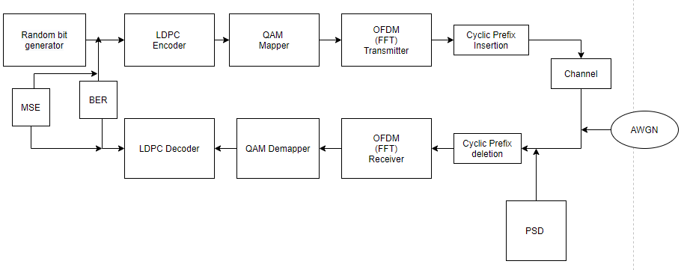
PSD,MSE and BER measurements-OFDM
parameter | value
Subcarriers | 6817
FFT size | 8192
CP length | 128
Modulation order | 64
Code rate | 3/5
FEC length | 128

Slide 13
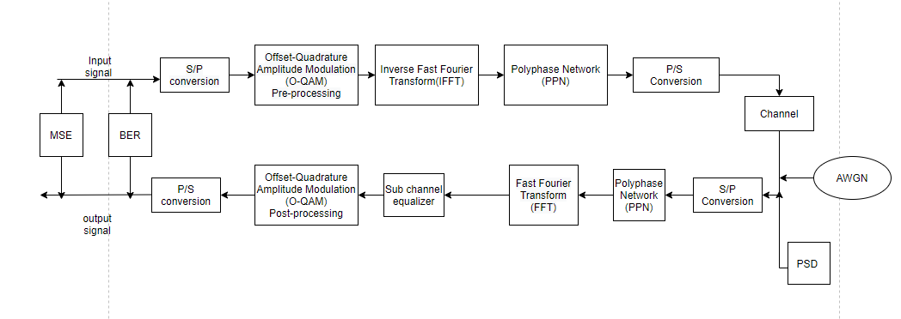
PSD,MSE and BER measurements-FBMC
parameter | value
subcarrier | 8192
Modulation order | 64
Overlapping factor | 16
Filter length | 256
Code rate | 3/5
FEC length | 128

Slide 14
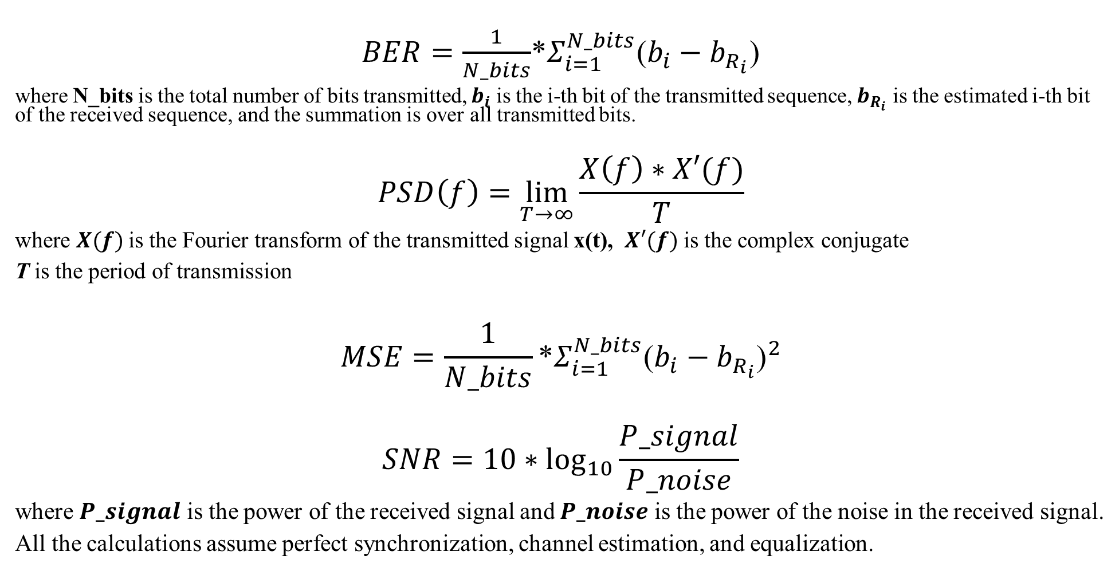
Formulas For : BER, PSD, MSE And SNR
$BER=\frac{1}{N_bits}$*$Σ_{i=1}^{N_bits}$($b_{i}−b_{R_{i}}$)
where N_bits is the total number of bits transmitted, $b_{i}$ is the i-th bit of the transmitted sequence, $b_{R_{i}}$ is the estimated i-th bit of the received sequence, and the summation is over all transmitted bits.
$$PSD\left(f\right)=\lim_{T→∞}{\frac{X\left(f\right)∗X′(f)}{T}}$$
where $X(f)$is the Fourier transform of the transmitted signal x(t), $X′(f)$ is the complex conjugate
T is the period of transmission
$$MSE=\frac{1}{N_bits}\text{∗}Σ_{i=1}^{N_bits}{\text{(}b_{i}−b_{R_{i}}\text{)}}^{2}$$
$$SNR=10∗\log_{10}{\frac{P_signal}{P_noise}}$$
where $P_signal$ is the power of the received signal and $P_noise$ is the power of the noise in the received signal.
All the calculations assume perfect synchronization, channel estimation, and equalization.

Slide 15
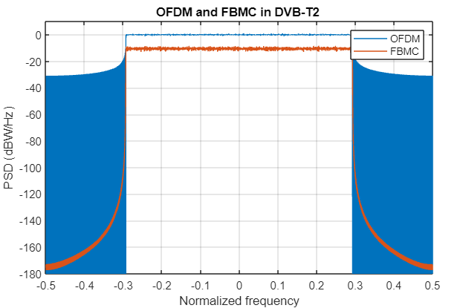
Results and Discussions
Power spectral density(PSD)
The plot shows that FBMC has a sharper cutoff and better spectral confinement compared to OFDM, which leads to higher spectral efficiency.
FBMC also has a lower out-of-band radiation compared to OFDM, which makes it more robust against interference and noise.

Slide 16
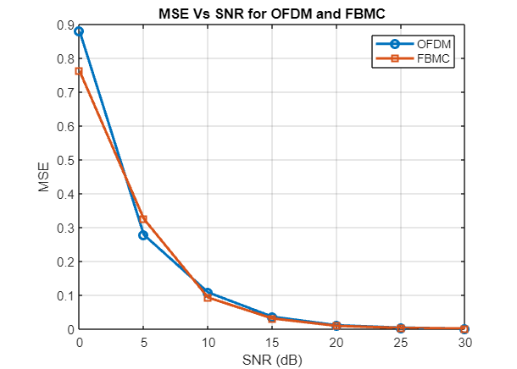
Results and discussions
Mean Square Error(MSE)
Both curves show a decreasing trend as the SNR increases, which means that the error decreases as the signal becomes stronger relative to the noise.
However, the slope of the FBMC curve is steeper than that of the OFDM curve, which indicates that FBMC is more resilient to noise than OFDM

Slide 17
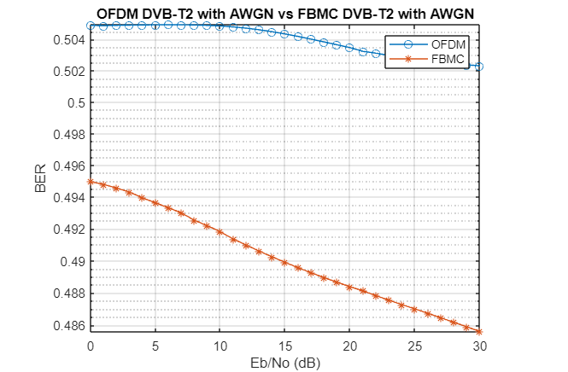
Results and discussions
Bit Error Rate(BER)
For both cases SNR increases with a decrease in BER, However, the plot also shows that FBMC has a lower BER than OFDM for the same SNR

Slide 18
Conclusions and recommendations
Based on the PSD, BER, and MSE results, we can draw the following conclusions and recommendations:
PSD: The PSD plot shows that FBMC has lower out-of-band radiation compared to OFDM. This makes FBMC a more attractive option in scenarios where the spectrum is congested and interference needs to be minimized.
BER: The BER curves show that FBMC performs better than OFDM in scenarios with higher SNR values. However, as the SNR decreases, the performance of FBMC starts to degrade, and OFDM becomes a better option.
MSE: The MSE results indicate that FBMC has lower average error compared to OFDM. However, it should be noted that the performance difference between the two techniques is not significant, and other factors such as complexity and implementation constraints should also be considered when selecting a modulation technique.
We noticed that the FBMC system performs better than the OFDM counterpart in the presence of the additive white Gaussian noise provided respectively for propagation. This performance under the AWGN channel, with 64-QAM modulation are inherent standards of the DVB-T2 standard.
FBMC technique is therefore an excellent waveform that could increase the DVB-T2 standard performance

Slide 19
References
[1] Li, L., Jiang, T., and Xiong, Z. (2015). FBMC Modulation for Future Wireless Systems: A Comprehensive Survey. IEEE Communications Surveys and Tutorials, 17(1), pp. 405-426.
[2] Bader, F. and Muta, O. (Eds.) (2018). Filter Bank Multicarrier Techniques for 5G Systems. Springer International Publishing.
[3] Zhang, H. and Tian, Y. (2017). Filter Bank Multicarrier and Its Applications in Communication Systems. John Wiley & Sons.
[4] Ismail, A., El-Sayed, A., and El-Mahdy, A. (2017). Performance Comparison of DVB-T2 and OFDM Based Broadcasting Systems in the Presence of Impulsive Noise. Wireless Personal Communications, 97(4), pp. 5811-5824
[5] .Next-generation digital television terrestrial broadcasting systems: Key technologies and research trends [6] Comparative Analysis of FBMC and OFDM Multicarrier Techniques for Wireless Communication Networks
[7]. Jingying Hu et al 2019 IOP Conf. Ser.: Mater. Sci. Eng. 677 032001 Performance Analysis of OFDM and FBMC [8]. Complexity analysis on 5G Candidate waveforms for DVB-T2: A survey

